Slide 1
Controlling (CO)
Curriculum: Introduction to S/4HANA using Global Bike

Slide 2

4.2 (August 2023)
S/4HANA 2022
Fiori 3.0
Global Bike
No Prerequisites needed

Slide 3
Bret Wagner
Stefan Weidner
Michael Boldau
Babett Ruß
Beginner

Slide 4
You are able to
define the central organizational structures of the CO module.
summarize the master data which is most important for the CO module.
explain standard controlling processes.

Slide 5
Agenda
CO Organizational Structure
CO Master Data
CO Processes
Innovations in S/4HANA

Slide 6
Agenda
CO Organizational Structure
CO Master Data
CO Processes
Innovations in S/4HANA

Slide 7
Goal of Controlling (CO)
Managerial Accounting – also termed Controlling – is designed to collect transactional data that provides a foundation for preparing internal reports that support decision-making within the enterprise.
These reports are exclusively for use within the enterprise and include:
Cost center performance
Profit center performance
Budgets analyses

Slide 8
Target Audience
Executives
Senior Management
Department Managers
Controllers
Cost Accountants

Slide 9
CO Organizational Structure
Represents the legal and/or organizational views of an enterprise
Forms a framework that supports the activities of a business in the manner desired by management
Permits the accurate and organized collection of business information
Supports the development and presentation of relevant information in order to enable and support business decisions

Slide 10
CO Organizational Structure
Client
An independent environment in the system
Company Code
Represents an independent legal accounting unit
Balanced set of books, as required by law, are prepared at this level.
A client may have more than one company code
United States
Germany
United Kingdom
Australia
…
Assets
Liabilities &
Owners Equity

Slide 11
CO Organizational Structure
Controlling Area
A self-contained, organizational unit for which the management of revenues and expenses can be performed
May include one or more company codes; therefore, an enterprise can perform management accounting analyses and reports across several companies
A way to identify and track where revenues and costs are incurred for evaluation purposes
Operating Concern
Represents a part of an organization for which the sales market is structured in a uniform manner
A operating profit for the individual market segments can be calculated.
Multiple controlling areas can be assigned to one operating concern.

Slide 12
Global Bike Structure for Controlling
Global Bike
Client
Global Concern
Operating
Concern
Controlling
North America
Controlling
Europe
Controlling
Area
Global Bike Inc.
Global Bike Germany GmbH
Company
Code

Slide 13
Global Bike Enterprise Structure in SAP ERP (Accounting)
Business Area
(see FI unit)
Business Area – Bikes BI00
CC CA00
CC GB00
CC AU00
CC JP00
CC US00
CC DE00
Company
Code
Chart of Accounts (global) GL00
Credit Control
Area
(see FI unit)
Credit Control Area (global) GL00
CA North Am. NA00
CA Europe EU00
CA Asia AS00
Controlling Area
Operating Concern (global) GL00
Client Global Bike
Notes:
Organizational units displayed in grey are not yet implemented, but are already planned in Global Bike.

Slide 14
Agenda
CO Organizational Structure
CO Master Data
CO Processes
Innovations in S/4HANA

Slide 15
CO Master Data
Profit Center
Responsible for revenue generation and cost containment
Evaluated on profit or return on investment
Enterprises are commonly divided into profit centers based on
Region
Function
Product
Cost Center
Responsible for cost containment, not responsible for revenue generation
One or more value-added activities are performed within each cost center.
Unit that is distinguished, for example, by area of responsibility, location, or type of activity
Copy center
Security department
Maintenance department

Slide 16
CO Master Data
Internal Order
Temporary cost collector responsible for cost containment, not responsible for revenue generation
It is used to plan, collect, and monitor the costs associated with a distinct short-term event, activity, or project
Company picnic
Trade show/Fair
Recruiting campaign
Revenue Element
A one-to-one linkage (mapping) between General Ledger revenue accounts and CO revenue elements is established to permit the transfer of FI revenue information to CO.
Posting in FI that impact revenue accounts lead to a posting in CO to a revenue element.
In other words, revenue account = revenue element – just different words depending on whether FI object or CO object.

Slide 17
CO Master Data
Cost Element
A one-to-one linkage (mapping) between General Ledger expense accounts and CO cost elements is established to permit the transfer of FI expense information to CO.
Postings in FI that impact cost accounts lead to a posting in CO to a cost element.
In other words, expense account = cost element – just different words depending on whether FI object or CO object.
Primary Cost Element
Originate in the General Ledger within FI and are automatically transferred to CO when an FI transaction is recorded in the General Ledger
Secondary Cost Element
Used exclusively in CO for allocations and settlements between and amongst cost centers

Slide 18
Primary vs. Secondary Cost Elements
Managerial
Accounting
(CO)
Financial
Accounting
(FI)
Aggregated Cost Elements
General Ledger Accounts
Income
Statement
Balance
Sheet
Secondary Cost
Elements
Primary Cost
Elements
Expense
Accounts
Revenue
Accounts
Notes:
This diagram shows the integration between Finance and Controlling:
The expense accounts are managed in both the P&L expense account and the primary cost element in controlling.

Slide 19
CO Master Data
Statistical Key Figures
Provide the foundation for accurate and effective cost allocations between cost objects
Utilized to support internal cost allocations involving allocations, assessments, and distributions
Examples:
number of employees
square footage
minutes of computer usage
Copy
Center
Activity
(20 Hours)
6 Hours
Executive Offices
10 Hours
Maintenance
Department
4 Hours
IT Department
Notes:
This figure shows an example of statistical key figures. A project cost center has 12 hours worth the activity. The statistical key figure is hours and is split at:
30% to the Work Center
50% to maintenance
20% to IS
All costs for the labor will be allocated in this fashion

Slide 20
Agenda
CO Organizational Structure
CO Master Data
CO Processes
Innovations in S/4HANA

Slide 21
Primary & Secondary Cost Elemen
Cost elements describe the origin of costs
Cost elements are defined as either
Primary cost elements arise through the consumption of production factors that are sourced externally
Secondary cost elements arise through the consumption of production factors that are provided internally.
Expenses and Revenue accounts in Financial Accounting correspond to Primary Cost and Revenue Elements
Secondary Cost Elements are used exclusively in CO to identify internal cost flows such as assessments or settlements. They do not have corresponding General ledger accounts in FI and are defined in CO only.
When you create a cost element, you must assign a cost element category. This Assignment determines the transactions for which you can use the cost element.

Slide 22
CO Processes
Posting Primary Cost Element
Financial Accounting (FI)
Supplies Expense
Cash
Debit Credit
Debit Credit
1,500
1,500
Managerial Accounting (CO)
Primary Cost Element
Cost Center
A

Slide 23
CO Processes
Posting Primary Cost Element
(FI) Transaction
Document
Amount
G/L Account #
Cost Center
1900012432
(CO) Transaction
Document
Cost Center
Cost Element
20000657
Financial Accounting (FI)
Supplies Expense
Debit Credit
Cash
Debit Credit
1,500
1,500
Managerial Accounting (CO)
Cost Center
1,500
Notes:
Transactions can have an effect on both FI and CO.
The transaction will create a debit and a credit for FI (FI transaction)
If CO is turned on a cost center or cost element bucket will be updated (CO transactions)

Slide 24
CO Processes
Posting Secondary Cost Element
Financial Accounting (FI)
Supplies Expense
Cash
Debit Credit
Debit Credit
1,500
1,500
Managerial Accounting (CO)
Secondary Cost
Element
Cost Center
A
CC 1
CC 2

Slide 25
CO Processes
Executive Offices
Posting Secondary Cost Element
Rent Expense
1,800
Debit Credit
1,500
Copy Center
Sec. Cost Element
Primary Cost Element
Maintenance Department
1,500
2,500
2,000
Supplies Expense
3,000
Debit Credit
Sec. Cost Element
2,500
Primary Cost Element
Information Services
Labor Expense
Primary Cost Element
Sec. Cost Element
1,200
Debit Credit
2,000

Slide 26
Types of Allocation
Distribution
Method for periodically allocating primary cost elements
Primary cost elements maintain their identities in both the sending and receiving objects
Sender and receiver cost centers are fully documented in a unique Controlling (CO) document.
Assessment
A method of allocating both primary and secondary cost elements
Primary and/or secondary cost elements are grouped together and transferred to receiver cost centers through use of a secondary cost element.
Sender and receiver cost centers are fully documented in a unique Controlling (CO) document.
Notes:
In Distribution and Assessment, you further allocate costs (or quantities for Indirect Activity Allocations) collected on a cost center during the accounting period to receivers, according to user-defined keys. These are therefore indirect allocation methods, because the exchange of activity is not the basis for allocating costs/quantities. Instead, user-defined keys such as percentage rates, amounts, statistical key figures, or posted amounts provide the cost/quantity assignment basis.
The advantage of these methods is that they are easy to use. You usually define the keys and the sender/receiver relationships only once.
Distribution and assessment are used primarily for cost centers. This is because direct cost allocation is not possible here due to the variety of transactions, the lack of clearly defined individual activity types and the fact that the entry of the activity is too time-consuming. For example, the costs of the company cafeteria may be assigned based on the number of employees in each cost center. Telephone costs are seldom allocated directly to the individual cost centers, but are collected on a clearing cost center for each period. They are then reposted or distributed at the end of the period according to the number of telephone units or telephone installations in each cost center.
Assessment is a method of allocating primary and secondary costs in Cost Center Accounting and Activity-Based Costing. The following information is passed on to the receivers:
The original cost elements are assigned cumulatively, or in groups, to assessment (secondary) cost elements. The original cost elements are not recorded on the receivers.
Sender and receiver information (sender cost center, receiver cost center, or business process) appears in the Controlling (CO) document.

Slide 27
Distribution
Sending cost center
Receiving cost centers
Primary cost element specifies allocation type
A010 – Administration
Rent Expense
$1,500
A005 –
D010 –
400 sft
550 sft
Distribution
A010 –
600 sft
D005 –
900 sft
A015
A020
150
100
S010 – 100
S005 –
200
Notes:
Distribution and administration having most of the square footage thus have the majority of the distribution costs.

Slide 28
Distribution
Sending cost center
Receiving cost centers
Primary cost element specifies allocation type
A010 – Administration
Rent Expense
$1,500
A005 –
D010 –
$200
$275
Distribution
A010 –
$300
D005 –
$450
A015
A020
$75
$50
S010 – $50
S005 –
$100
Notes:
Distribution and administration having most of the square footage thus have the majority of the distribution costs.

Slide 29
Assessment
Sending cost center
Receiving cost centers
Primary and secondary cost elements
D010 – 10%
A020 – IT
Software Expense
$4,200
A020 – IT
Supplies Expense
$500
A005 – 15%
A010 – 5%
Assessment
D005 – 20%
A015 – 10%
A020 – 0%
S010 – 10%
S005 – 30%
Notes:
In this example IT expenses are accumulated. Periodically, the costs are reallocated to the primary and secondary cost elements based upon the budgeting and expense policy of the company. Notice how Sales now has a much larger portion than the other departments.

Slide 30
Assessment
Sending cost center
Receiving cost centers
Primary and secondary cost elements
A020 – IT
Software Expense
$4,200
A020 – IT
Supplies Expense
$500
A005 – $705
D010 – $470
Assessment
A010 – $235
D005 – $940
A015 – $470
A020 –$0
S010 – $470
S005 – $1,410

Slide 31
SAP CO Module
Fully integrated with other SAP modules including, but not limited to:
Financial Accounting (FI)
Materials Management (MM)
Sales and Distribution (SD)
Production Planning and Execution (PP)

Slide 32
Agenda
CO Organizational Structure
CO Master Data
CO Processes
Innovations in S/4HANA

Slide 33
Innovations in S/4HANA
No separate cost element master data maintenance anymore
Universal Journal combines account assignment of Controlling
Technical changes in material ledger

Slide 34
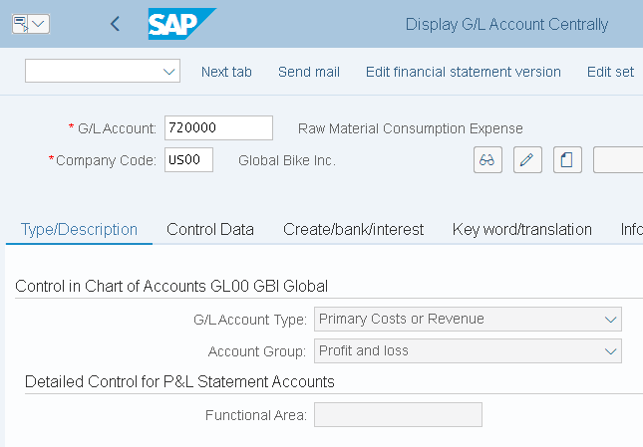
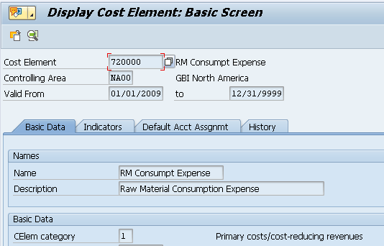
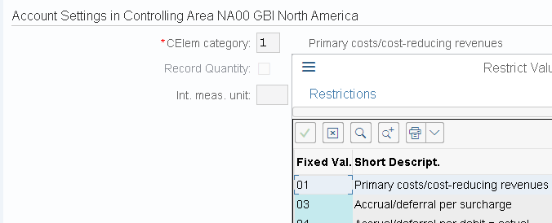
Innovations in S/4HANA 1) Cost element master data maintenance
No separate cost element master data maintenance anymore
Part of chart of accounts, are managed in GL account master data
Transactions not available anymore: KA01,KA02,KA03,KA06
Default account assignments (cost center, order) will be transferred from cost element masters to table TKA3A (view using transaction OKB9)
The GL account master record includes a new
mandatory field for cost element category for
classification of GL accounts
Previously in KA01

Slide 35
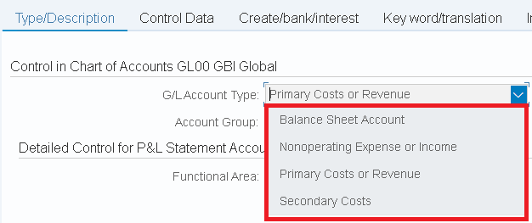
Innovations in S/4HANA 1) Cost element master data maintenance
GL accounts have now attributed on three levels:
1. Chat of accounts area
2. Company-code-specific area
3. Controlling-area-specific area
New account types for primary costs/revenues and secondary costs
Journal entries are recorded under GL accounts (secondary and primary costs)

Slide 36
Innovations in S/4HANA 2) Universal Journal
Universal Journal combines account assignment of Controlling (cost center, WBS element..), Profitability Analysis (products, customers..) and Enterprise Controlling (profit center)
In previous architecture, many reconciliation work was necessary because the components for P & L representations were structured differently and stored in different tables
More flexibility: reporting on following dimensions: profit center, functional area, cost center, internal order, project and market segment
SAP Accounting versus SAP ERP
SAP ERP
stability
flexibility
Advantages:
Harmonized external and internal reporting
Increased flexibility in reporting and analysis
No need for coordination
Significantly reduced memory requirements
Compatibility Views for the sum / index tables
Reporting continues to work
totals & indices
External accounting
processing
Logistics
receipt
FI
receipt
CO
receipt
Predefined aggregates
totals & indices
Internal accounting
analytics
SAP Accounting
stability
flexibility
Logistics
receipt
Universal Journal Entry
processing
Aggregation on the fly
through HANA views
analytics
One place of administration-> across applications

Slide 37
Innovations in S/4HANA 2) General Ledger
General Ledger in S/4HANA is based in the Universal Journal
Line items are stored in the new database table ACDOCA -> optimized to SAP HANA
no need for CO real-time integration for transfer of secondary CO postings to New GL or the Reconciliation Ledger of Classic GL
CO internal postings are now visible in General Ledger as well
The new journal entry consists of a header (table BKPF) and the respective items (table ACDOCA).
The ACDOCA table contains all fields needed for G/L, CO, AA, ML, PA, providing one single source of truth for all these modules. For CO, the universal journal also contains all cost elements, including secondary cost elements, which are also in SAP S/4HANA G/L accounts.
Notes:
https://help.sap.com/doc/554b6154b6718c4ce10000000a4450e5/2.6/en-US/276e8854d45da064e10000000a423f68.html

Slide 38
Innovations in S/4HANA 2) Universal Journal
Advantages:
No need for coordination
Significantly reduced memory requirements
External and internal accounting are harmonized
Flexible, multi-dimensional real-time analyses can be executed directly from the Universal Journal - without replication of the data into the BI.
There are apps for:
reporting on cost centers, internal orders, projects, sales, items and reporting on market segments based on the account-based approach
There aren’t yet apps for:
reporting on commitments for any of the CO account assignments, reporting on target costs, variance categories, intercompany eliminations, reporting on budget, allotted costs, work in process or results analysis, reporting on cost estimates

Slide 39
Innovations in S/4HANA 3) Technical Changes in Material Ledger
The use of Material Ledger (ML) is now obligatory and automatically active in all SAP S/4HANA systems
fulfills two basic objectives:
the ability to manage material prices in multiple currencies/valuations: Material inventory values are normally managed by the system in only one currency (company code currency). The material ledger enables the system to manage inventory values in additional currencies/valuations. This is achieved by updating all goods movements in the material ledger. Currency amounts are translated into foreign currencies at historical exchange rates directly at the time of posting.
and actual costing: with the purpose of determining actual costs for externally procured materials and materials produced in-house
In addition, actual costing uses actual costs to valuate inventories of raw materials, semi finished products, and finished products
Actual costing calculates an actual price (periodic unit price) for each material, into which all actual costs for the particular period flow.

Slide 40
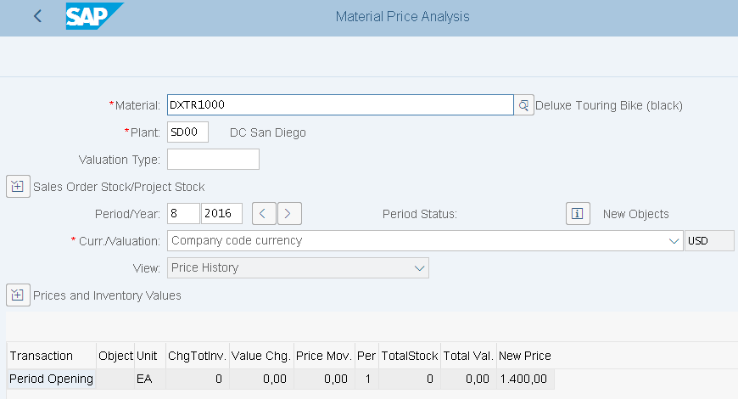
Innovations in S/4HANA 3) Technical Changes in Material Ledger
It is no longer allowed to use an ML type that references currency settings defined in FI or CO
Transaction CKM3PH (Price Determination Structure)
replaces CKM3 / CKM3N
provides an improved view of materials in plants with
active Actual Costing
All views offered by CKM3/CKM3N are no longer
available, except CKM3 Price History view
(via CKM3PH for all materials)

